Slide 1




DISPLAYS SALES PERFORMANCE DATA
and Products olist
Dibimbing
DATA SERIES 10.0 PROJECT BUSINESS INTELLIGENCE
NABILA PUTRI ASY SYIFA

Slide 2

CASE STUDY
Create a dashboard in Tableau with Olist Dataset to help users
get insights, so business decisions can be taken quickly.
The dashboard will display insights on user questions
like:
What are the trends in orders and payment value per month each year?
What is the percentage of orders per payment value group?
- Expensive (> 750000)
- Medium (250 > 750
- Cheap (< 250)
How many customers and sellers and how many orders
in each state?
Draw a map of state and city distribution of the number of orders and
the amount of the payment value
How does each product perform?
Users will also be greatly helped if there are interactive filters or parameters,
such as Order Status, Payment Type, and others.

Slide 3
DATA UNDERSTANDING
In this case, using a sales dataset from 2017 to 2018, there are 4 tables used to visualize, including:
Orders Table: Order information
Order_Payments table: Payment information
Customers table: Customer information
Sellers Table: Seller information
Order_Payments
ORDERS
Customer
Sellers

Slide 4
DATA UNDERSTANDING
Order_purchase
timestamp
Order_id
ORDERS TABLE
Order_approved_att
Customer_id
This table is sales data information which contains order numbers, customer numbers, sales numbers, order status, and many others. You can see the details in the picture below.
Order_delivered_carrier_date
ORDERS
Seller_id
Order_delivered_customer_date
Product
Order_estimated_delivery_date
Order_status

Slide 5
DATA UNDERSTANDING
ORDER_PAYMENTS TABLE
Order_id
This table is payment data information that contains price, installment details, payment methods used, and many others. You can see the details in the image below.
Payment_value
ORDERS
PAYMENTS
Payment_sequential
Price
Payement_type
Freight_value
Payment_insallments

Slide 6
DATA UNDERSTANDING
CUSTOMERS TABLE
Customer_id
his table is customer data information which contains customer_id, customer region, both country and city and many others. You can see the details in the image below.
Customer_state
Customer_unique_id
Geolocation_lat
CUSTOMERS
Customer_zip_code
Geolocation_lng
Customer_city

Slide 7
DATA UNDERSTANDING
SELLERS TABLE
his table is customer data information which contains id_seller, seller region, both country and city and many others. You can see the details in the image below.
Seller_state
Seller_id
Geolocation_lat
SELLERS
Seller_zip_code
Geolocation_lng
Seller_city

Slide 8
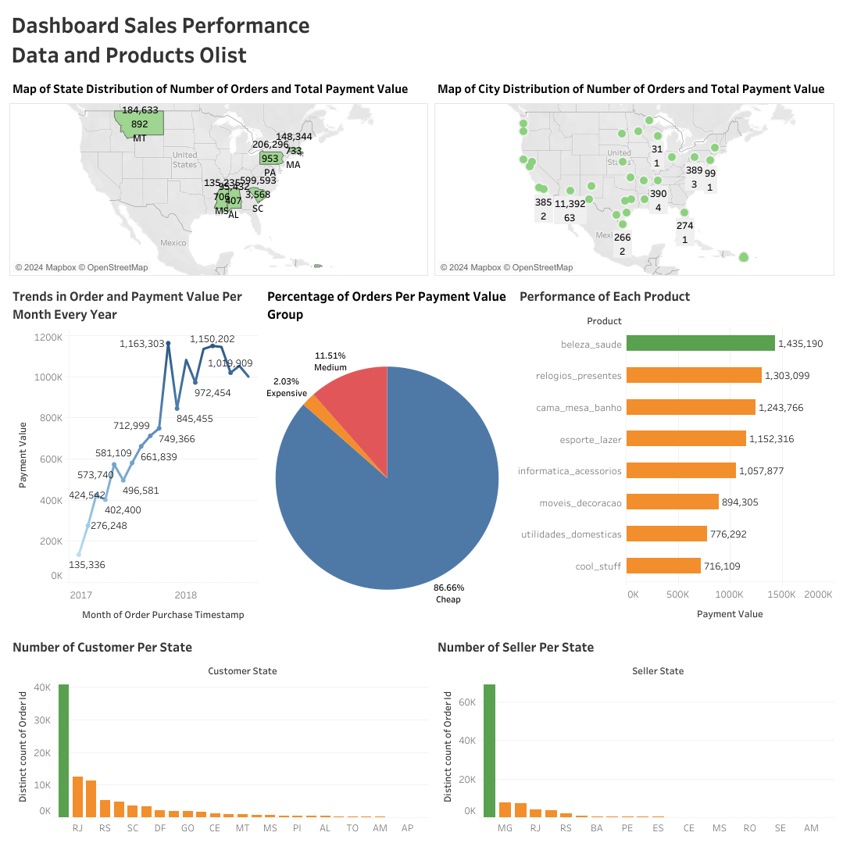
DASHBOARD

Slide 9
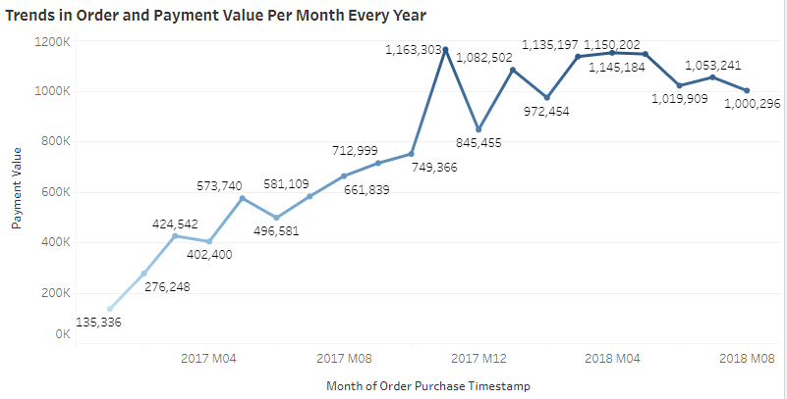
ORDER TRENDS AND PAYMENT VALUE PER MONTH EVERY YEAR
Order trends and payment values ​​increased from month to month in 2017 until mid-2018, with the peak occurring in December 2017, experiencing the highest orders and payments, namely 1,163,303 orders.

Slide 10
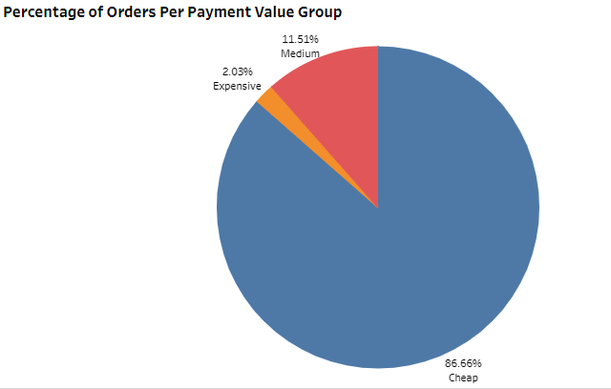
GROUP PAYMENT VALUE PERCENTAGE
It is known from the data visualization results that the payment value percentage category consists of 3, namely cheap, medium and expensive. It can be seen that there is a difference in the percentage of payment value categories, namely that the majority of orders are in the "Cheap" payment value category with a percentage of 86.66%. Meanwhile, orders with respective values ​​of "Medium" with a percentage of 11.51% and "Expensive" with a percentage of 2.03%, shows that only a small portion of orders have a high value.

Slide 11
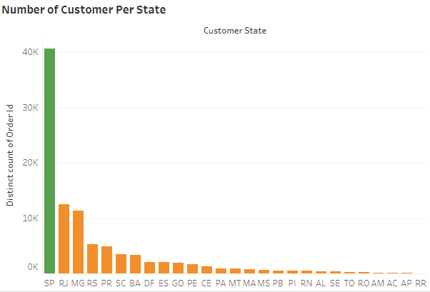
NUMBER OF ORDERS, CUSTOMER AND SELLERS IN EACH STATE
This is the result of visualizing the number of customers and the number of orders in each section in each country. Based on the visualization results, it can be seen that the state of SP (São Paulo) has the highest number of customers and number of orders, namely 40,000 orders, also with a significant difference compared to other states. This shows that there is a large demand for Olist products in São Paulo.

Slide 12
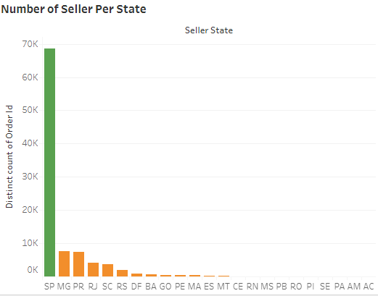
NUMBER OF ORDERS, CUSTOMER AND SELLERS IN EACH STATE
This is the result of visualizing the number of sellers and the number of orders in each section in each country. Based on the visualization results, it can be seen that the state of SP (São Paulo) has the largest number of sellers and orders, namely 70,000 orders. It can be seen that if we highlight the order situation, São Paulo (SP) has a high number of sellers and customers, which indicates a positive correlation between the number of sellers and orders. However, in states such as Minas Gerais (MG) and Rio de Janeiro (RJ), although the number of sellers is quite high, the number of customer orders is not as high as in São Paulo. This shows that a large number of sellers does not always mean a large number of orders.

Slide 13
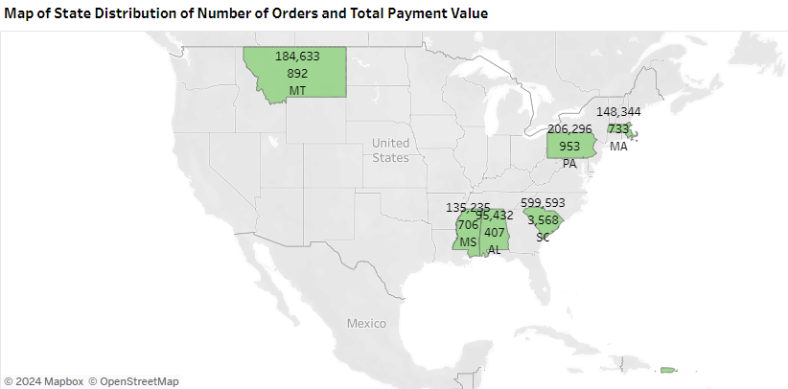
MAP OF THE DISTRIBUTION OF STATES AND CITIES AGAINST THE NUMBER OF ORDERS AND
total payment value
This is the result of state distribution map visualization of the number of orders and payment value. Based on the distribution of states that have a high number of orders and significant payment values, namely the customer state in South Carolina (SC) with Number of Orders: 3,568 and Payment Value: 599,593 .

Slide 14
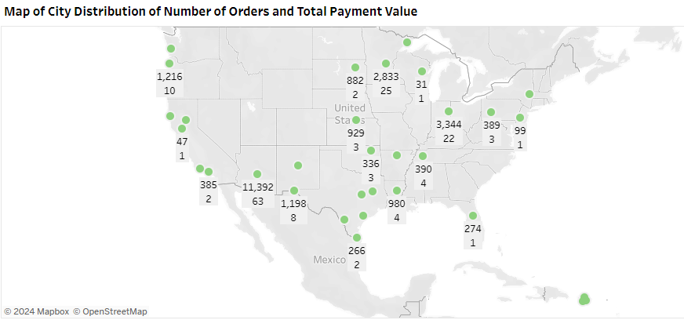
MAP OF THE DISTRIBUTION OF STATES AND CITIES AGAINST THE NUMBER OF ORDERS AND
total payment value
This is the result of the city distribution map visualization of the number of orders and payment value. Based on the distribution of cities that have a high number of orders and significant payment values, namely the customer city in Vitoria with Number of Orders: 376 and Payment Value: 62,270.

Slide 15
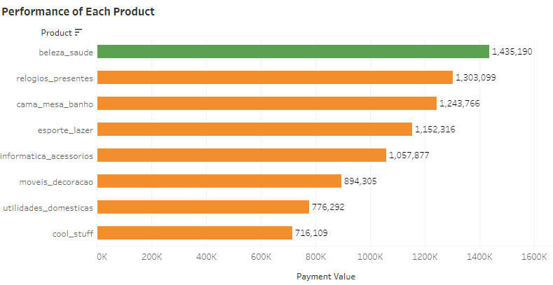
PERFORMANCE OF EACH PRODUCT
This is the visualization result of 8 products that had high sales levels during 2017-2018. It can be seen that the baleza_saude product is the best-selling product with total sales of 1,435,190.

Slide 16
CONCLUSION
Market Concentration: The market is highly concentrated in São Paulo (SP), both in terms of sellers and buyers, indicating that SP is a center of e-commerce activity.
Transaction Value: While the majority of orders are in the low value (“Cheap”) category, there is a significant contribution from the “Medium” and “Expensive” categories.
Popular Products: Some products like “beleza_saude” are very popular and have a high payout value, which shows customer preference for these products.
Payout Trends: There is an upward trend in payout rates, with a peak at the end of 2017, followed by steady fluctuations showing relatively high payout levels.
Geographic Distribution: Certain states and cities show a high number of orders and payment values, indicating a strong market in those locations.

Slide 17





Let’s Connect
+62857 - 1194 - 2921
nabilaputriasysyifa99@gmail.com
www.linkedin.com/in/nabila-putri-asy-syifa
nabila_afs

